Slide 1

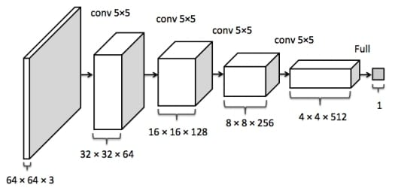
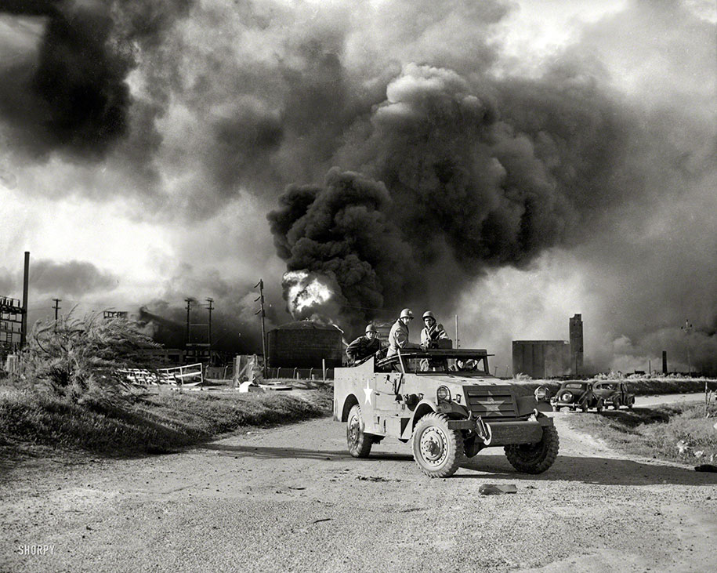
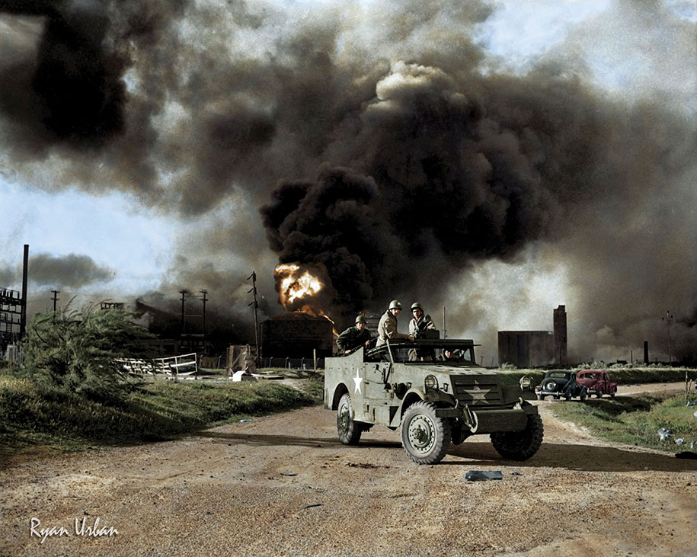
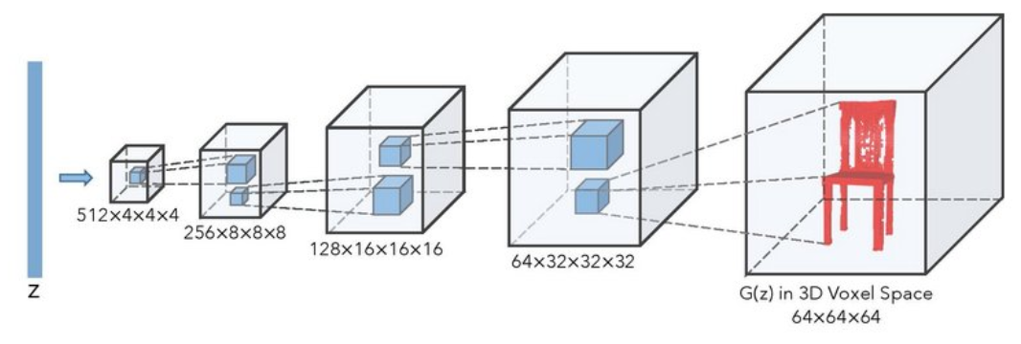
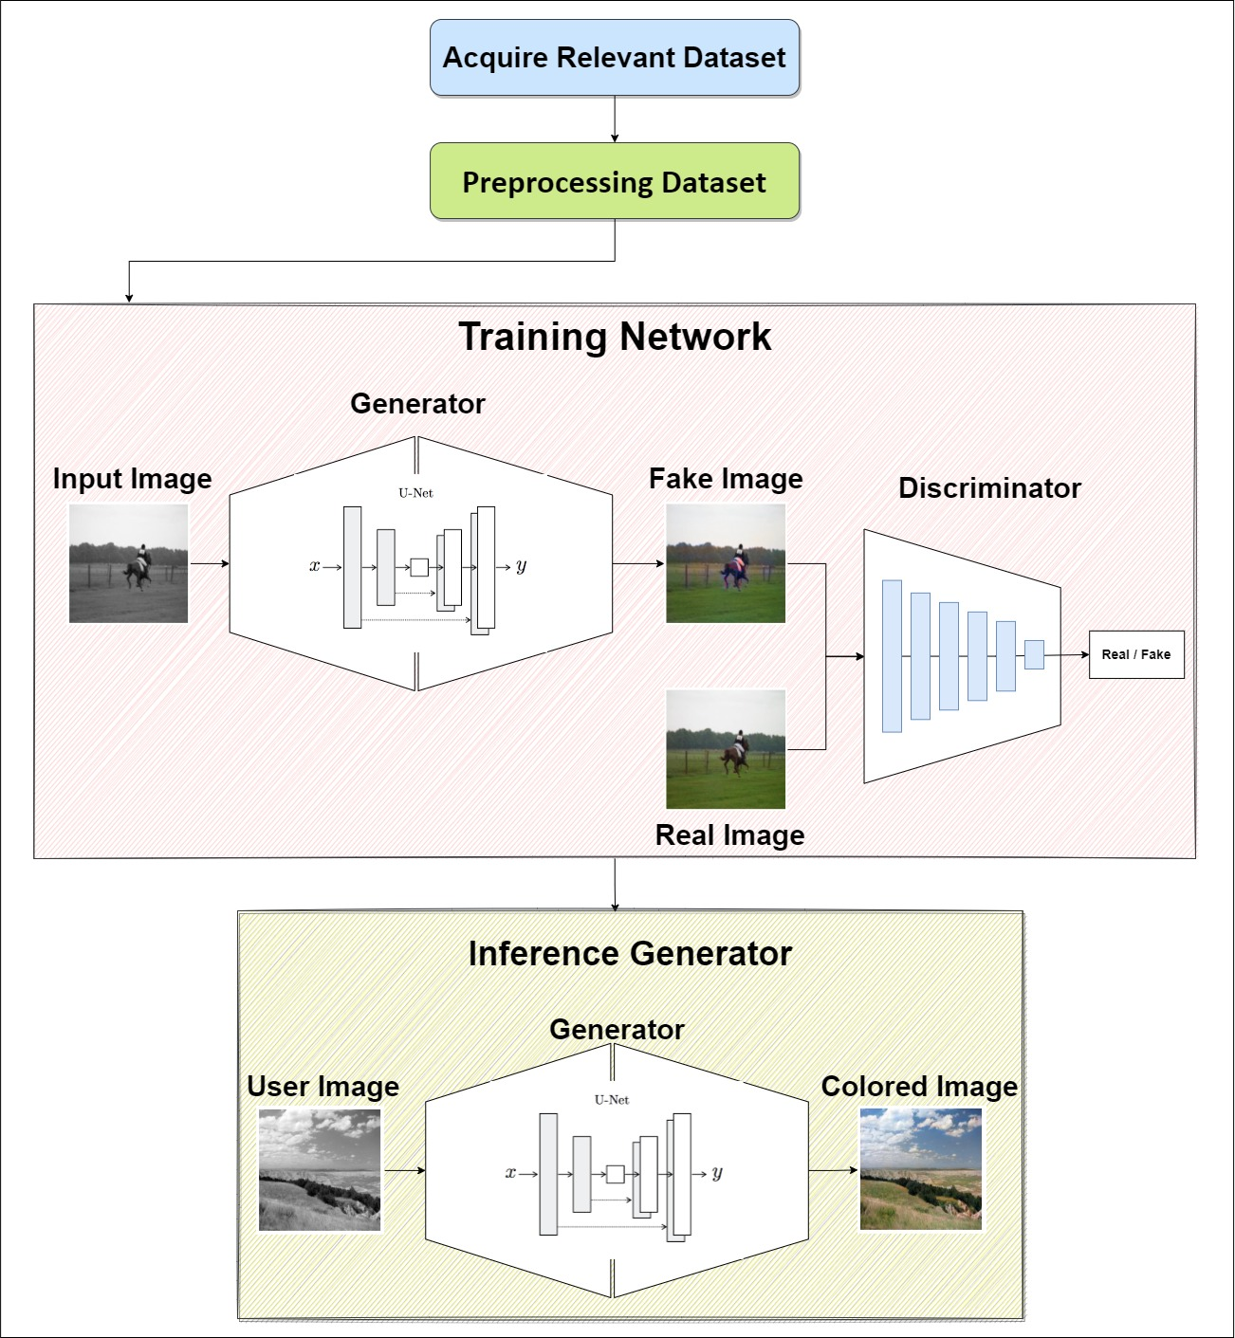
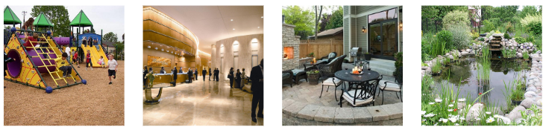
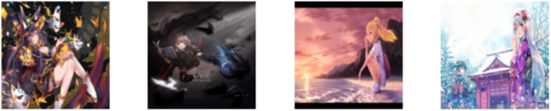
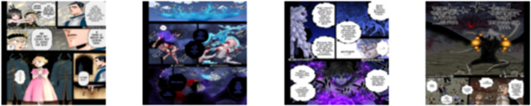
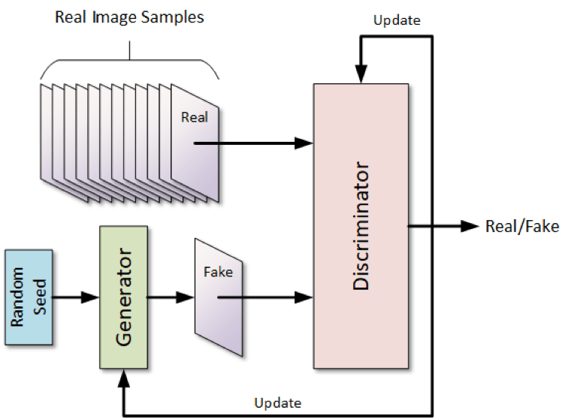
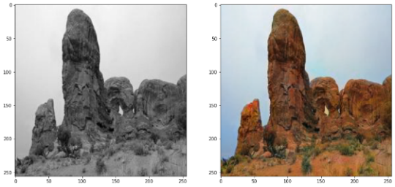
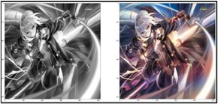
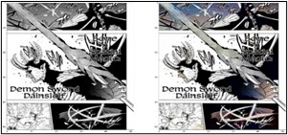
Coloring Black & White Images Using Generative Adversarial Networks (GAN)
Ahmed Alkhayal || Abdulaziz Ebrahim || Turki Al-Zahrani
Instructor: Dr. Mohammed J. Abdulaal
Motivation
Background
Image colorization is a field that has been explored since the invention of media capture devices. From the mid-1800s till this day, image coloring was and still is done either the traditional way of hand coloring or via computer applications; in both cases the process is done by expert artists. These old methods are both expensive and time-consuming. In addition, artists can manipulate images in ways that could alter their historical significance. The aim of this project is to develop a fully automated system that is fast, scalable, and requires no human intervention to color grayscale images.
GANs are made up of two parts: Generator and Discriminator both parts compete against each other making them better at their tasks.
Discriminators are used to classify whether images are real or fake
Generators creates fake images from noisy input (latent vectors z)
Methodology
Datasets
Our system uses techniques based on the state-of-the-art general solution for image-to-image tasks proposed by Berkeley AI Research [1]. The system consists of four steps:
Acquiring relevant dataset (8000 images minimum)
Data preprocessing and format conversion
Training the model
Detaching the generator network for inference
Places365
Annotated Anime
Black Clover Manga
Preprocessing Methods
RGB to L*a*b conversion
Image resizing
Image rescaling
Image augmentation
Image batching
Model
Results
Conclusion
After training the model on the three datasets for 100 epochs each:
Concluding from the results we obtained, our system looked very reliable even on the small scale we trained on. And detaching the generator network provided us with a small and fast network that could potentially be used in real-time applications like real time coloring of camera feed from space or in mines and caves.
Scaling Potential
Increasing training data
Using pretrained network as the feature extractor parts of the model
Places365 Annotated Anime
Black Clover Manga
References
[1] J.-Y. Z. T. Z. A. A. E. Phillip Isola, "Image-to-Image Translation with Conditional Adversarial Networks," 2022.
To determine the accuracy of the model two participants were asked to distinguish between real and fake colored images by our model. They were both presented 9 fake and 1 real image:
Person 1: had an accuracy of 50% equivalent to randomly guessing
Person 2: had an accuracy of 40% worse than randomly guessing
Acknowledgements
Instructor Dr. Mohammed J. Abdulaal
Machine Learning Engineer Moein Shariatnia
EE490 - AI for Audio and Image Signals
Computer and Electrical Engineering
King Abdulaziz University
Contact details:
Ahmed Alkhayal: ahmed.alkhayal@gmail.com +966 50 880 5534
Abdulaziz Ebrahim: azez214@gmail.com +966 53 298 3708
Turki Al-Zahrani: axa00770@gmail.com +966 55 143 5548
Dr. Mohammed J. Abdulaal: Mjabdulaal@kau.edu.sa

